Slide 1
Backend Architecture: Microservices Application Infrastructure
System Overview with Data Flow and Control Flow

Slide 2
Microservices-based application infrastructure system
Key Components:
Registry Server
Repository Server
Server Lifecycle Manager
Logging Server
Load Balancer Server

Slide 3
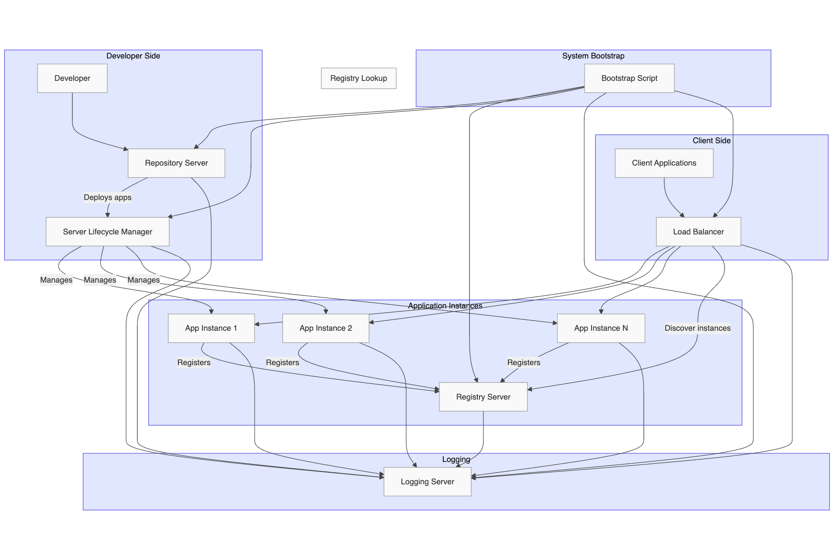

Slide 4
Registry Server
Purpose: Manages application registrations and configurations
Functions:
Tracks available application instances
Maintains configuration data
Provides service discovery

Slide 5
Core Components - Repository Server
Purpose: Handles application package storage and retrieval
Functions:
Stores application ZIP packages
Validates package structure
Notifies Server Lifecycle Manager of new applications

Slide 6
Core Components - Server Lifecycle Manager
Purpose: Manages the lifecycle of application servers
Functions:
Deploys applications
Creates isolated environments
Starts/stops application instances
Monitors application health

Slide 7
Core Components - Logging Server
Purpose: Provides centralized logging
Functions:
Collects logs from all components
Standardizes log format
Enables system-wide monitoring

Slide 8
Core Components - Load Balancer
Purpose: Distributes traffic among application instances
Functions:
Routes client requests
Queries registry for available instances
Applies load balancing algorithms
Tracks request metrics

Slide 9
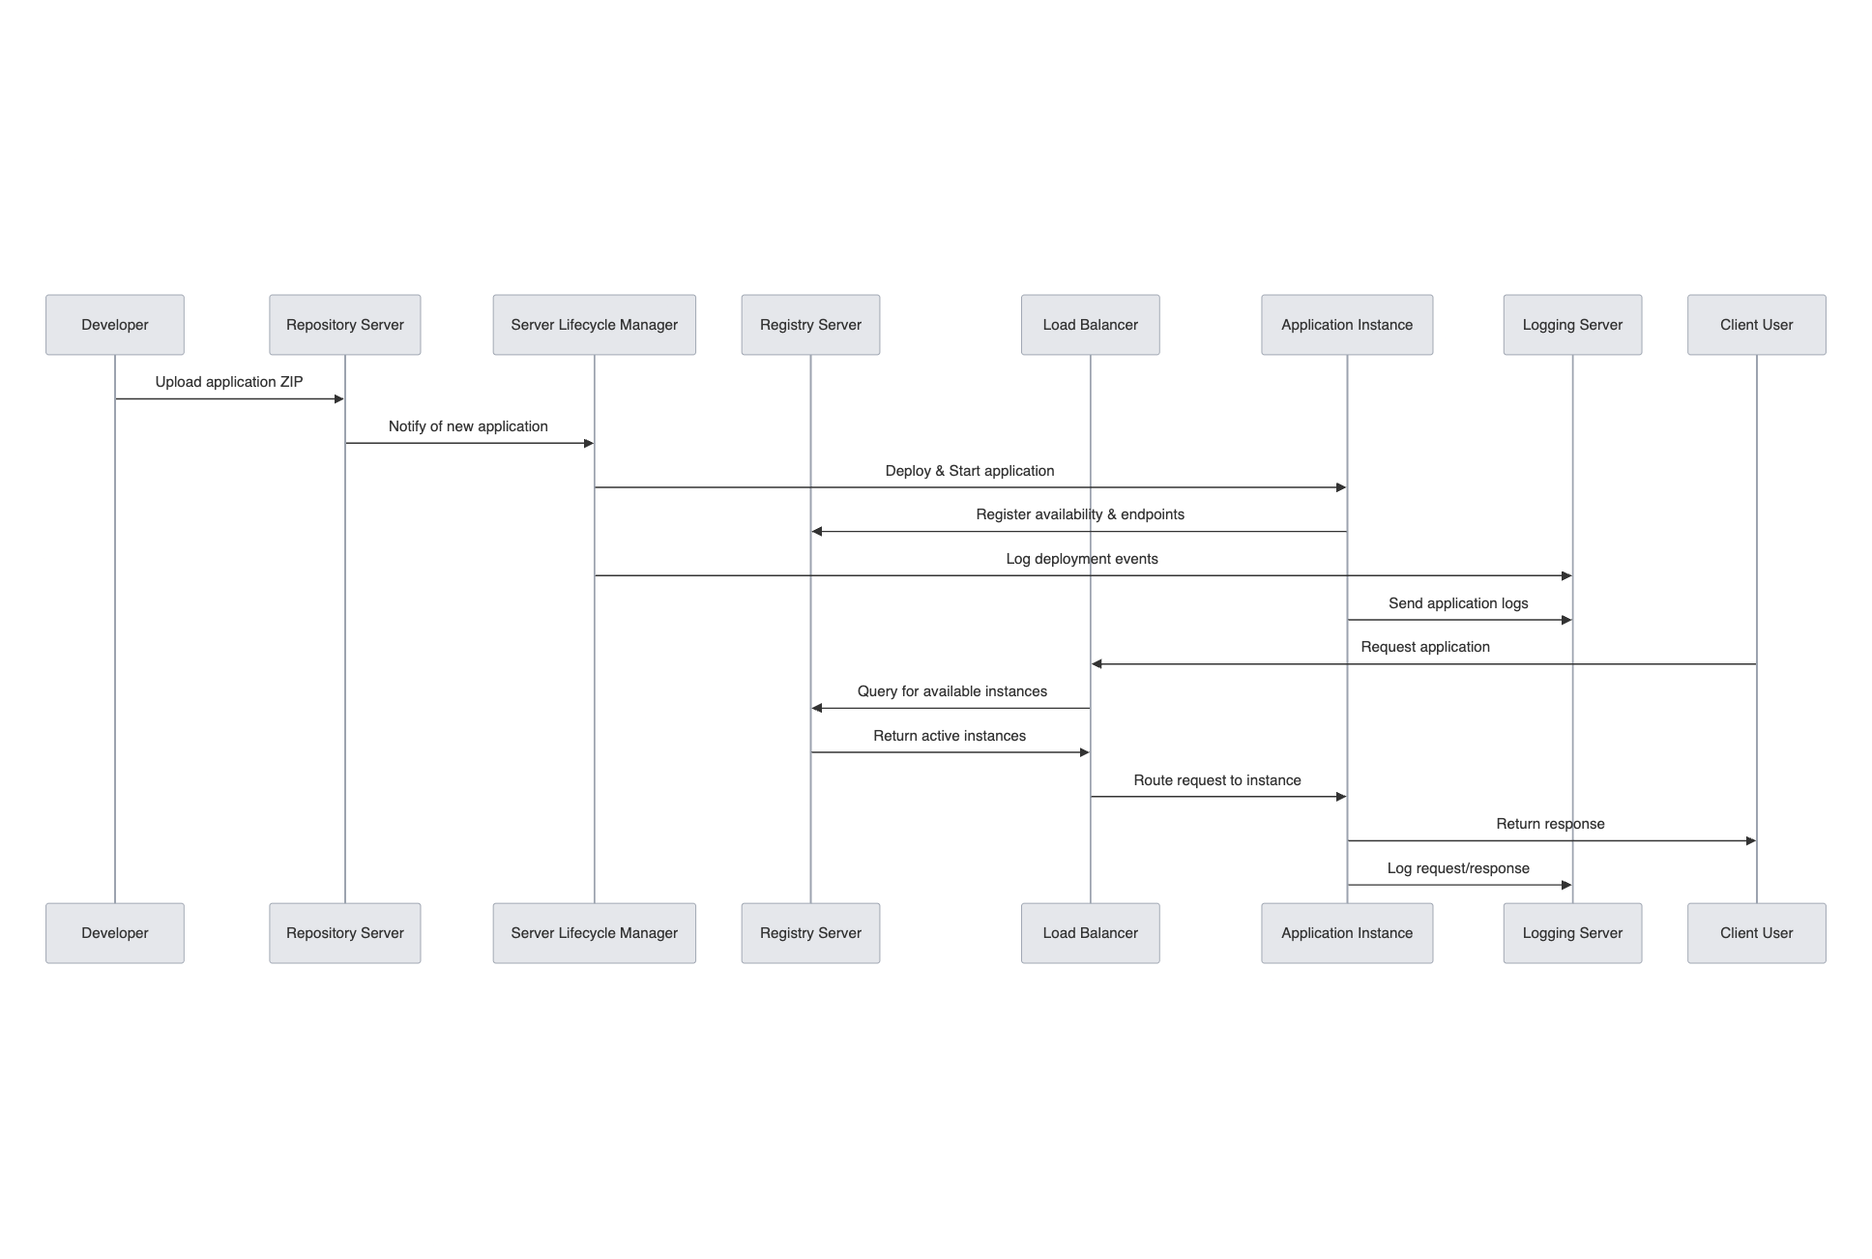
Data Flow Diagram

Slide 10
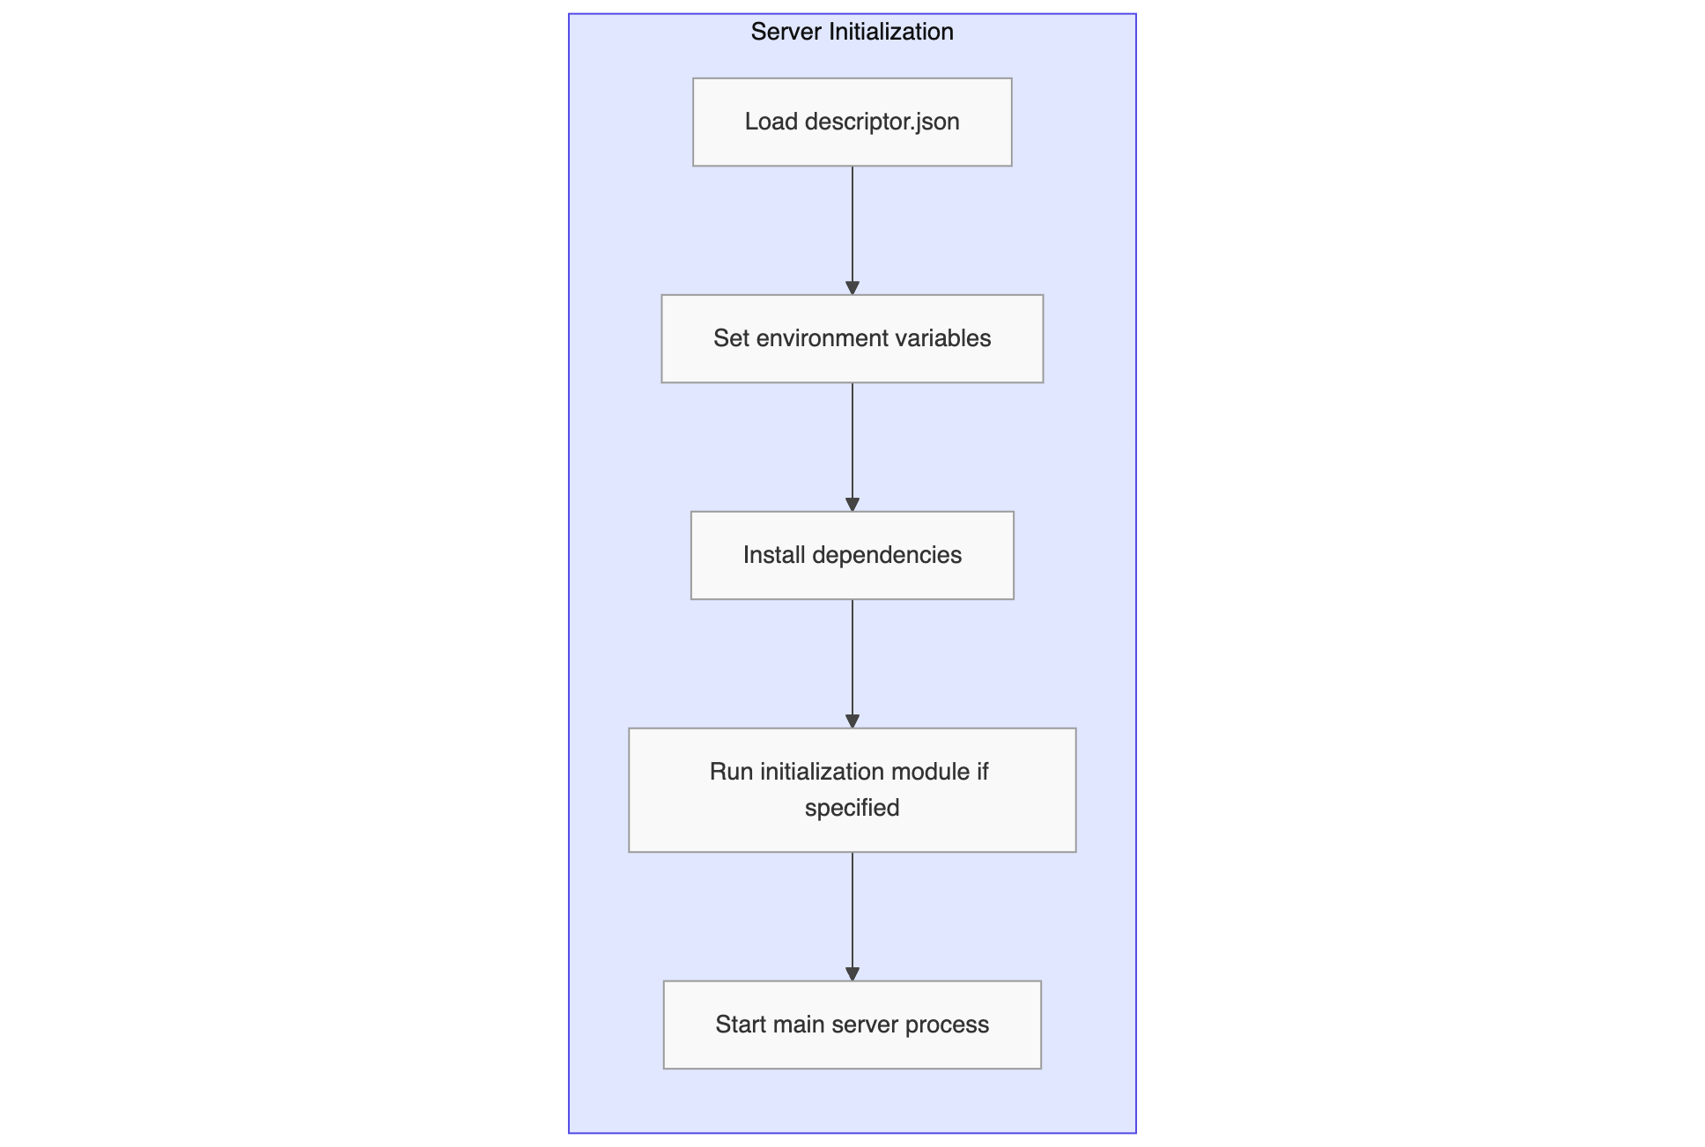
Server Component Initialization

Slide 11
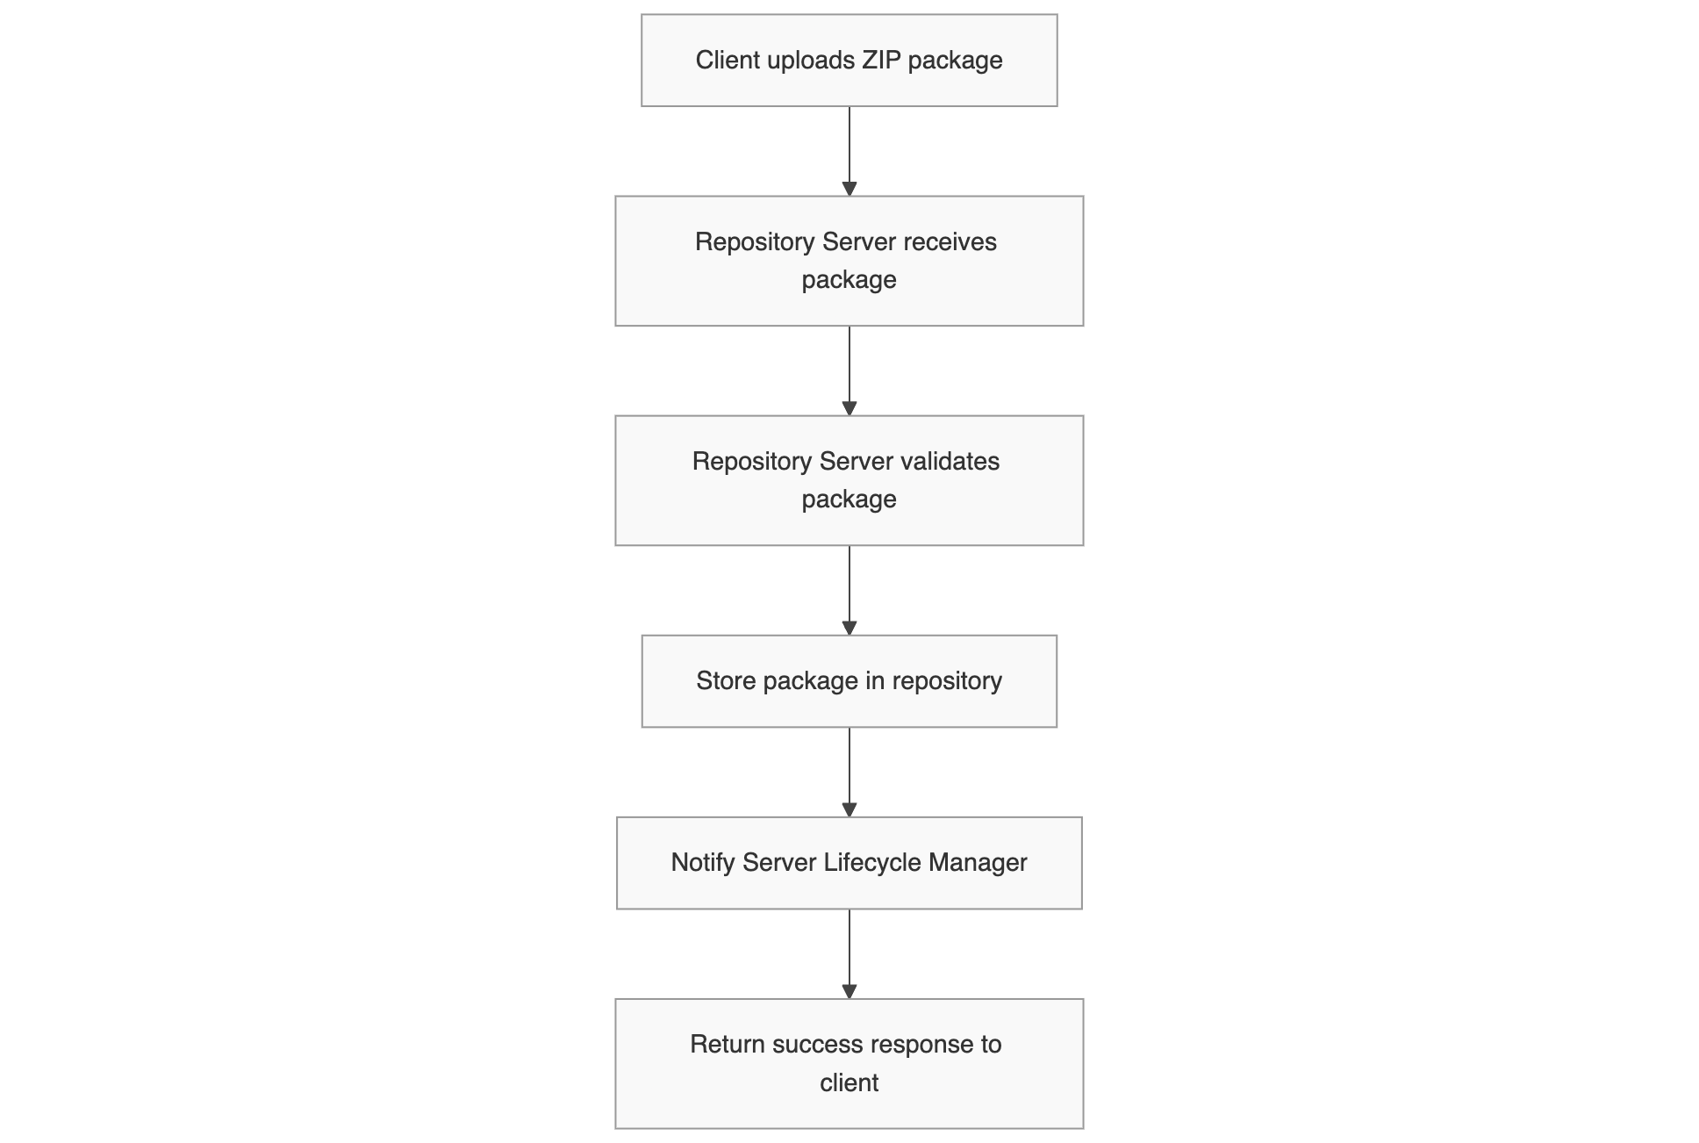
Repository Server Workflow

Slide 12
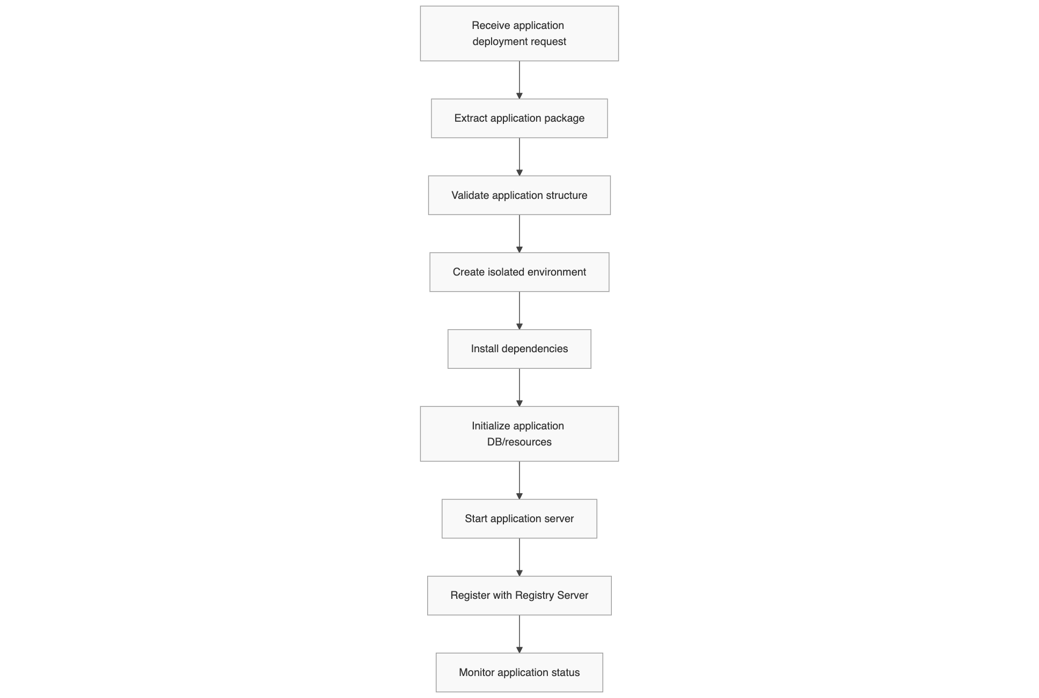
Server Lifecycle Manager Workflow

Slide 13
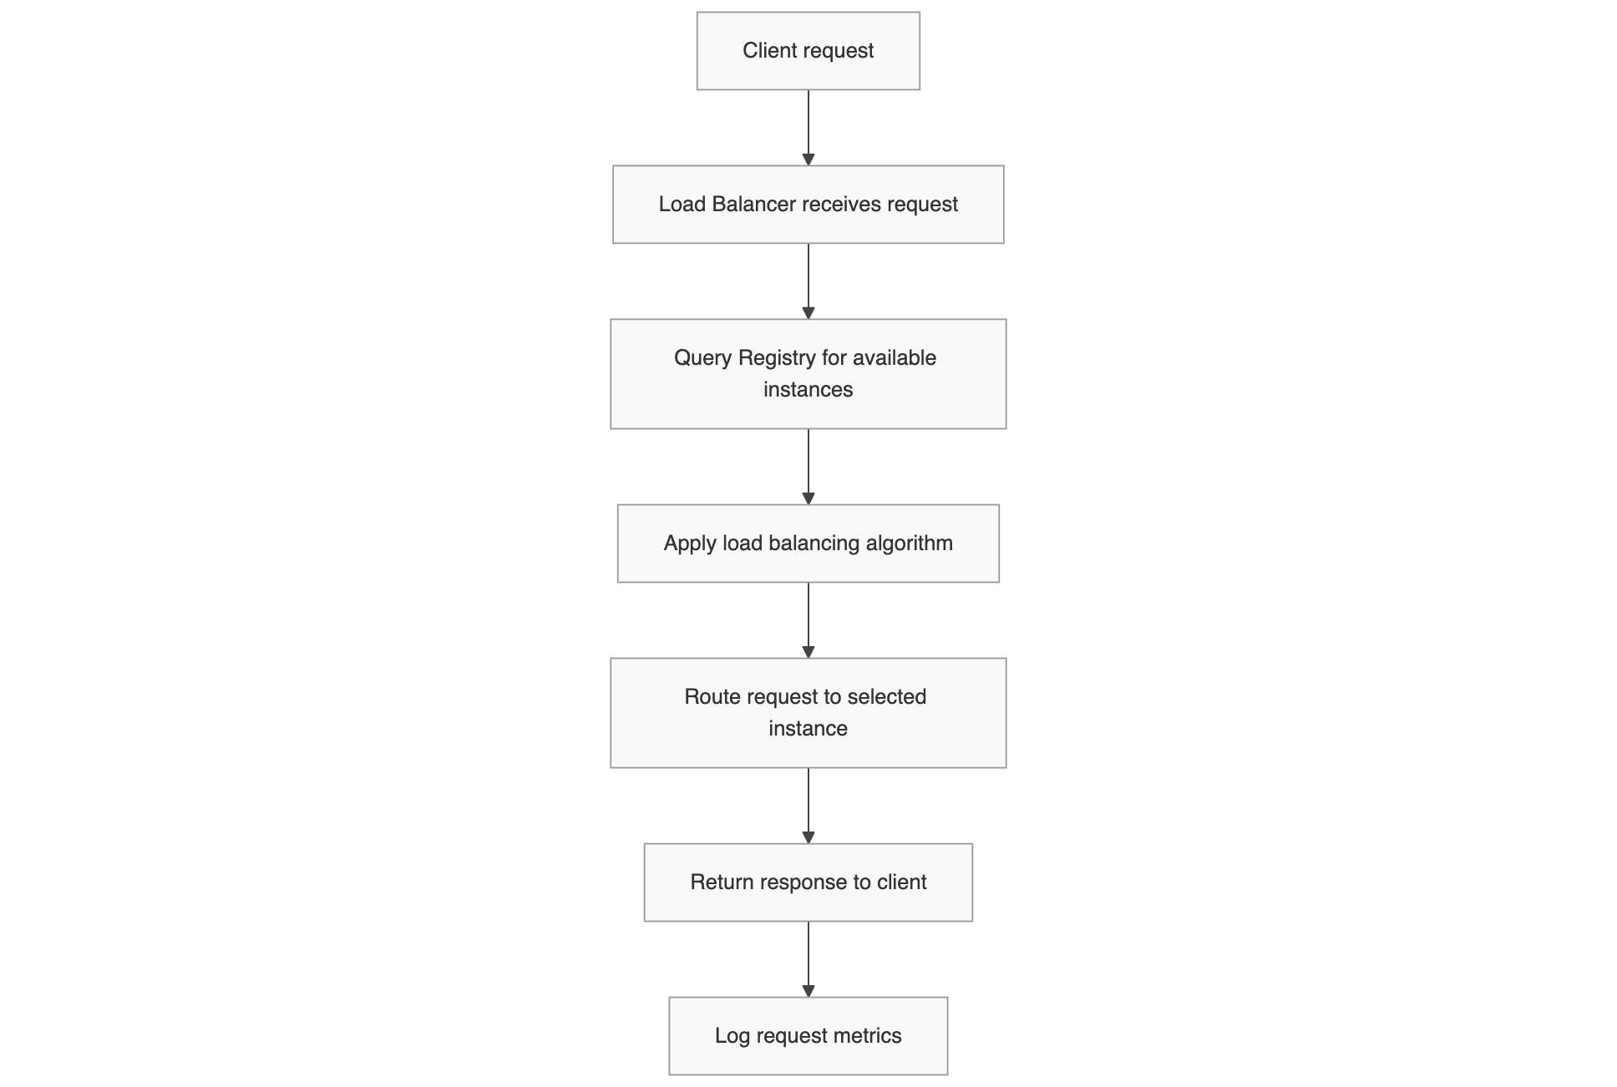
Load Balancer Request Flow

Slide 14
Key Backend Features
Microservices Architecture
Decoupled services for scalability and fault isolation
Environment Isolation
Dedicated Python virtual environments
Isolated dependencies
Standardized Configuration
descriptor.json for consistent setup
Process Management
Subprocess-based tracking
Centralized Logging
System-wide log collection

Slide 15
Technical Implementation
Language & Runtime: Python with virtual environments
Server Deployment: Gunicorn for web services
Configuration: JSON-based configuration files
Process Management: Python subprocess module

